Slide 1
Coursera Capstone
San Diego High School Recommendation
Sunil Yadavalli
February 2020

Slide 2
Business Problem
Assume that someone got a job opportunity in the beautiful city of San Diego, California. Where you would recommend the locality to stay so that there are enough high schools around with a minimal commute?
Also, in the available options, which school would be the best option to opt for if there is a chance of admission?

Slide 3
Data
To address the above problem, we would need the below:
List of the neighborhoods in San Diego
The latitude and longitude of those neighborhoods
Venue data, particularly the high schools.
We will leverage the Foursquare API to collect the data, apply the machine learning techniques on this data and utilize map visualization to arrive at a solution.

Slide 4
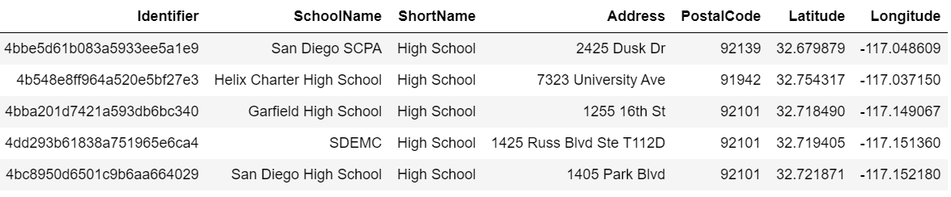
Below is the sample data

Slide 5
Methodology
We will use Foursquare API to get the top 50 venues that are within a radius of 10000 meters
We use the CategoryID of the High School (which can found on the Foursquare API documentation) and pass it as a parameter to the call to get the high school information.
After gathering the data, we will populate the data into a pandas DataFrame and then visualize the neighborhoods in a map using Folium package.

Slide 6
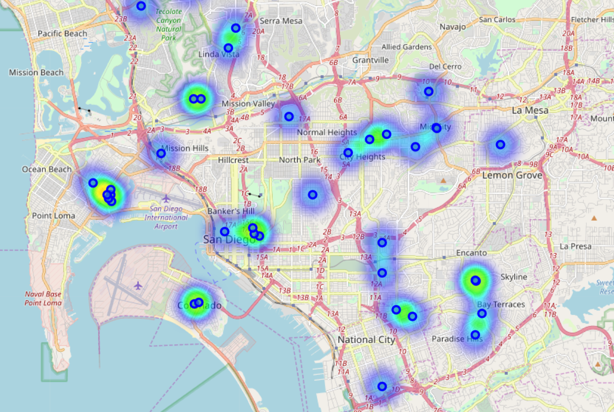
Results
Heatmap with the high schools visualization is shown in the below figure

Slide 7
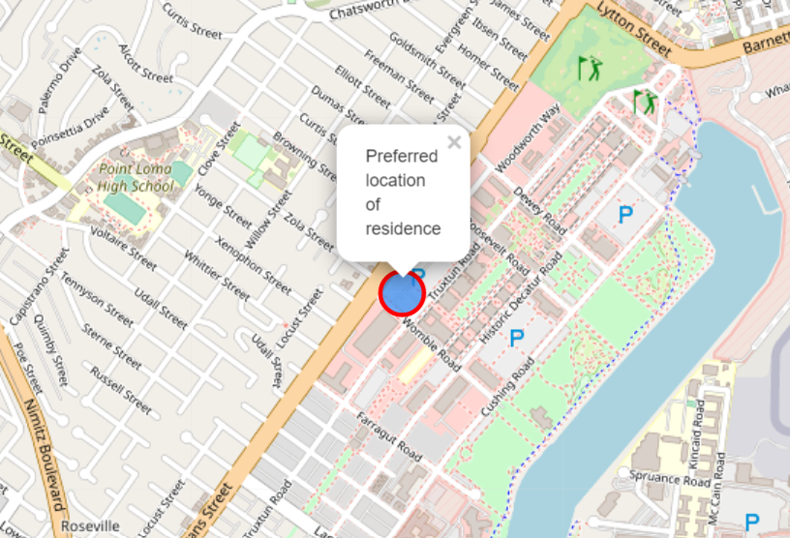
Based on the randomly picked latitude and longitude the proposed area of residence to look for is around the Womble Road

Slide 8
Discussion
We could further update our dataframe based on the ratings for each of the high school. Also, additional tips on them would help us further make a better choice. However, due to the limitation of the regular API membership we could not do that.
This could be the potential area of interest when we deal with a real-world problem.

Slide 9
Conclusion
In this project, we have gone through the process of identifying the business problem, specifying the data required, extracting and preparing the data, performing machine learning and lastly providing recommendations to the relevant stakeholders
To answer the business question that was raised in the business problem section, the answer proposed by this project is: The neighborhoods having the postal code 92106 are the most preferred locations to find a residence.

Slide 10
THANK YOU

